Slide 1


DARS
Data Analysts for your Recommender System

Slide 2
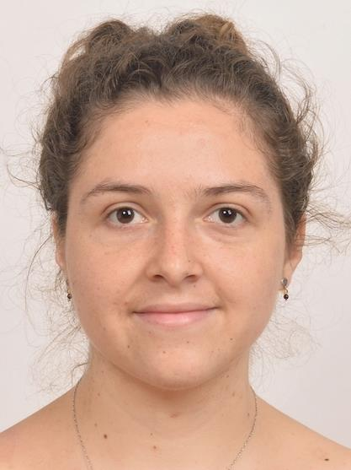
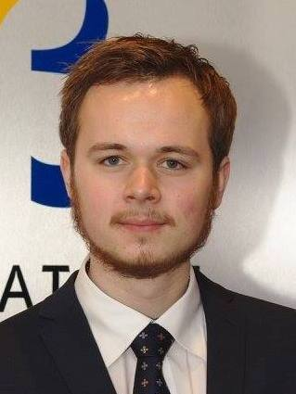

Sofia Vazquez Alferez
sofia.vazquezalferez@maastrichtuniversity.nl
Raphaël Morsomme
raphael.morsomme@maastrichtuniversity.nl

Slide 3

Content
DARS
A Course Recommender System for Students
Prototype
Side-product

Slide 4
1. DARS

Slide 5
The Project
Started in September 2018
Course Recommender System for MSLAS Students
Supporting Team:
Department of Knowledge Engineering, Maastricht University
Institute for Data Science, Maastricht University

Slide 6
Objectives
Help students make well-informed decisions w.r.t. course selection
Improve self- and academic advising
App

Slide 7
Stakeholders
Curriculum Development
Students
Academic Advisors

Slide 8
2. A Course Recommender System for Students

Slide 9
Recommender System
Topic Modelling
Predictive Model
LDA
Regularized linear regression
Recommender System
output =
Course Recommendations
output =
Warnings & preparatory courses

Slide 10
Topic Modelling
Input
Textual description of courses:
Fit Topic Model
Course Recommendation
App: selection of key words
LDA
Model selection: perplexity, coherence, log-likelihood (future)
Vary: $α,β$ and $n$
Vary: 𝛼,𝛽 and 𝑛
Course manuals
Course catalogue
Identify matching courses
student topic profile
Course literature (future)

Slide 11
Predictive Model
Input
Transcripts (2,500)
Fit Linear Model
Warnings
Regularized (Lasso & C.V.)
Predictors
Past academic performance
Topic expertise
A model for each course
App: selection of courses
Grade prediction
If predicted grade is low
Issue a warning
Suggest preparatory courses

Slide 12
3. Prototype

Slide 13
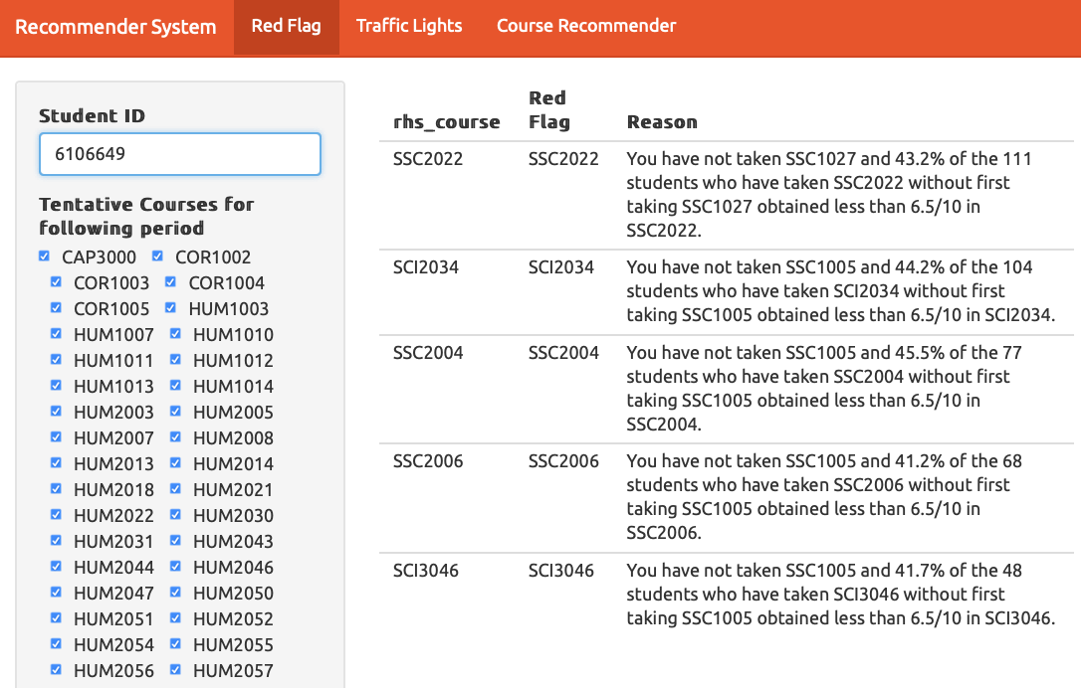

Slide 14
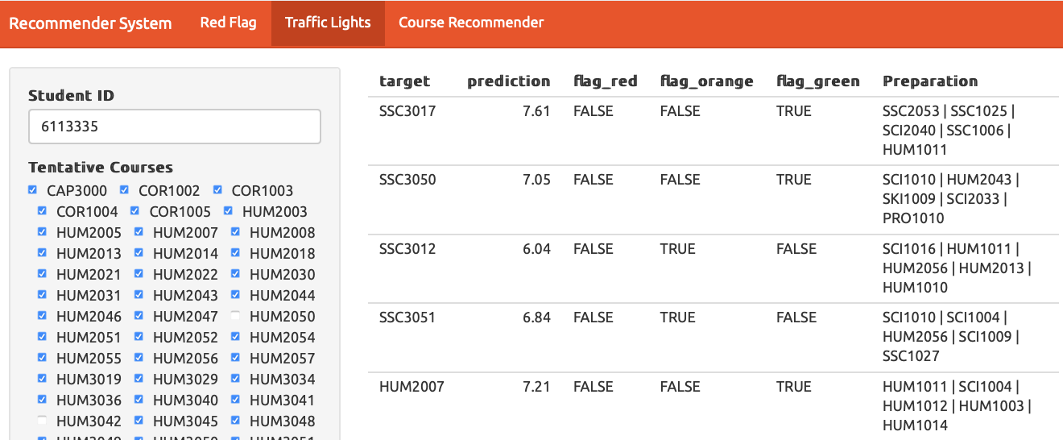

Slide 15
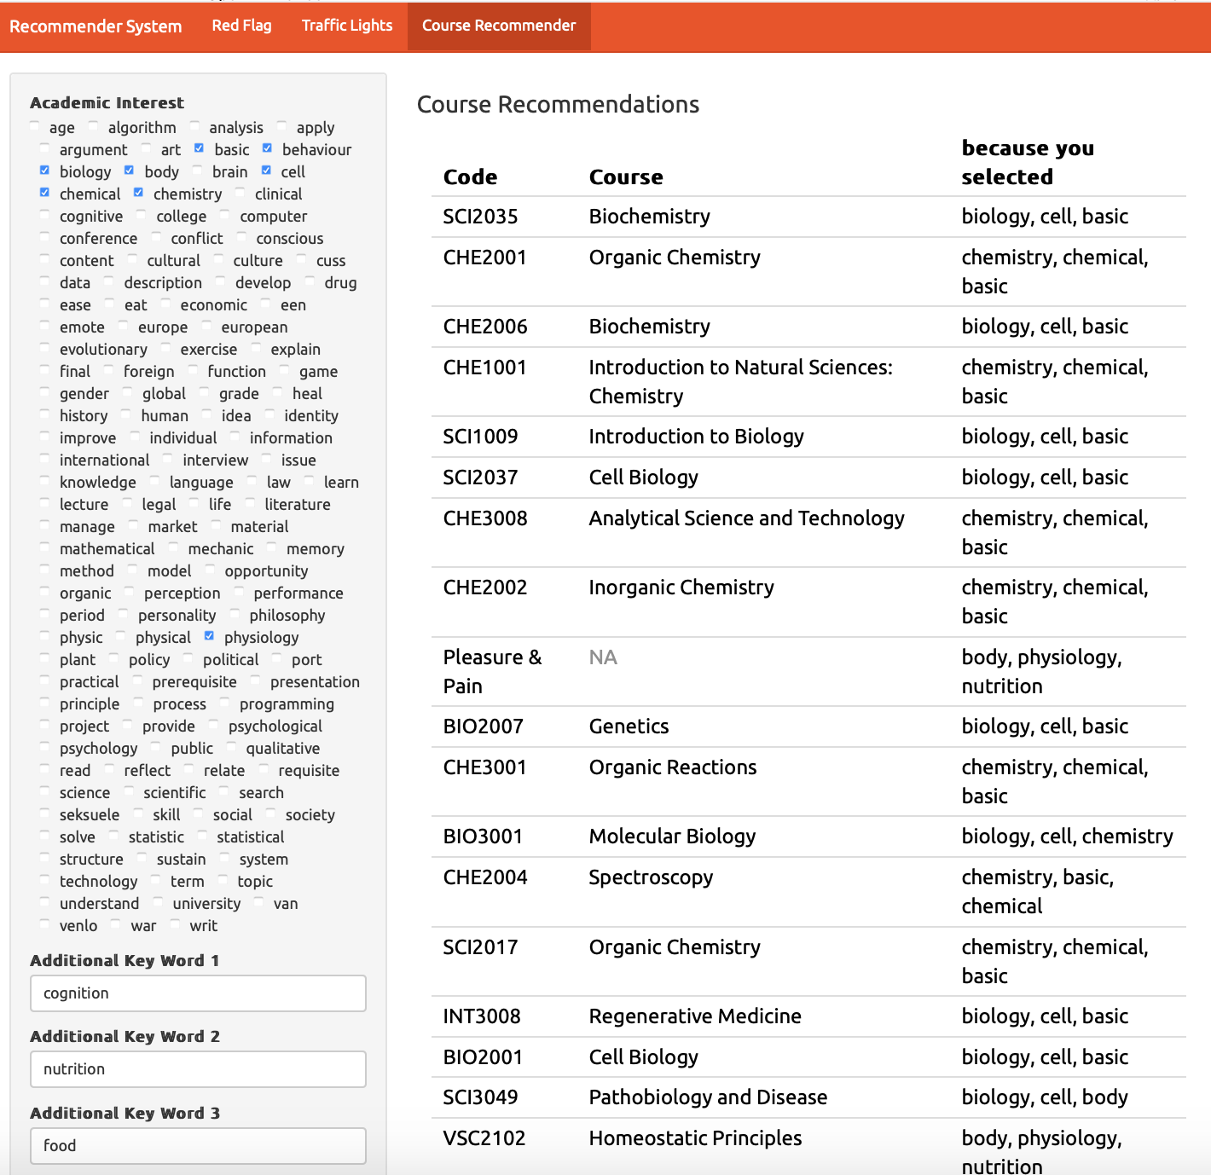

Slide 16
3. Side-products

Slide 17
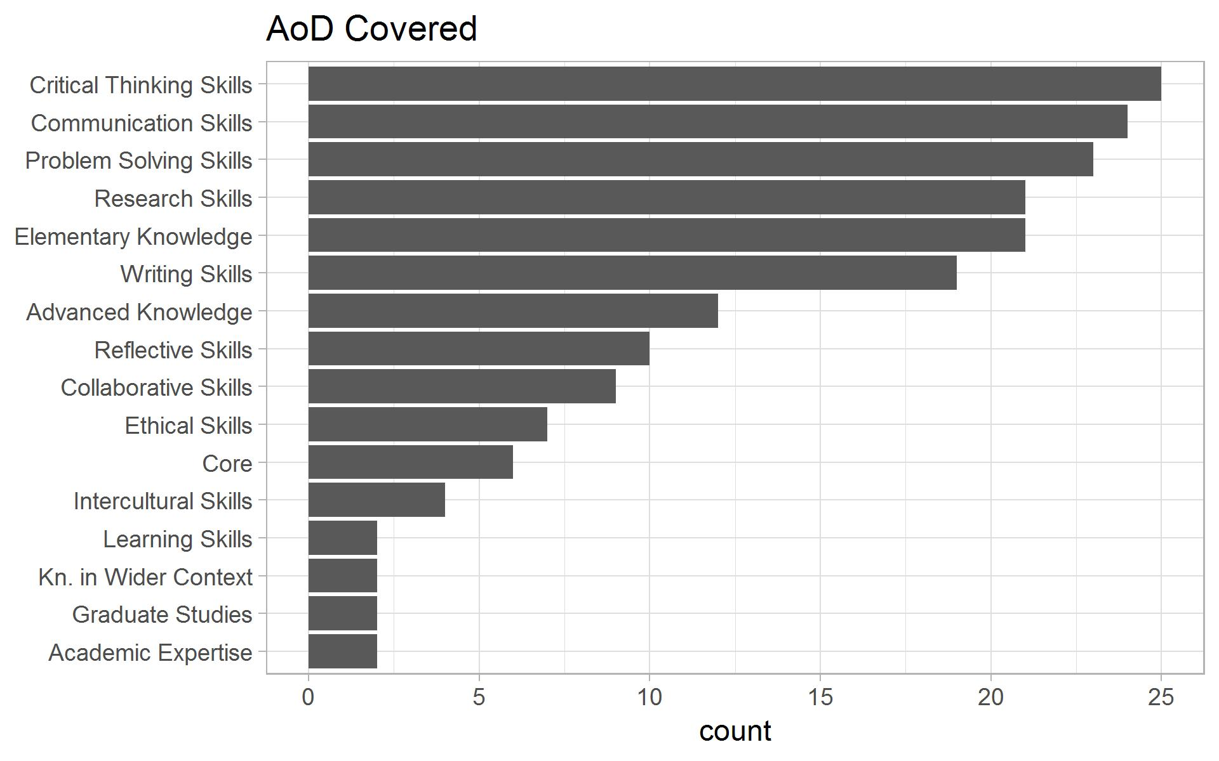
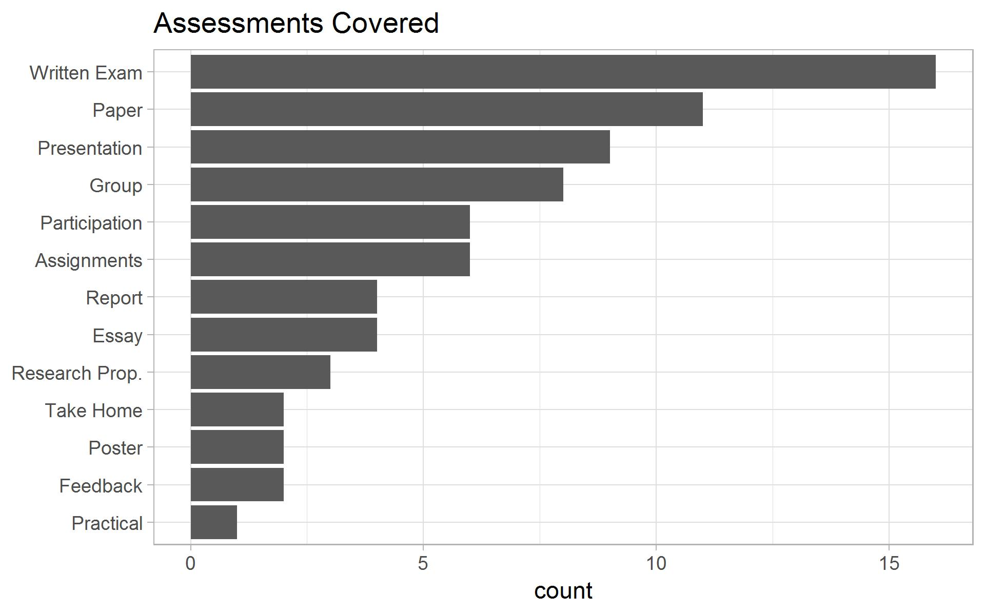
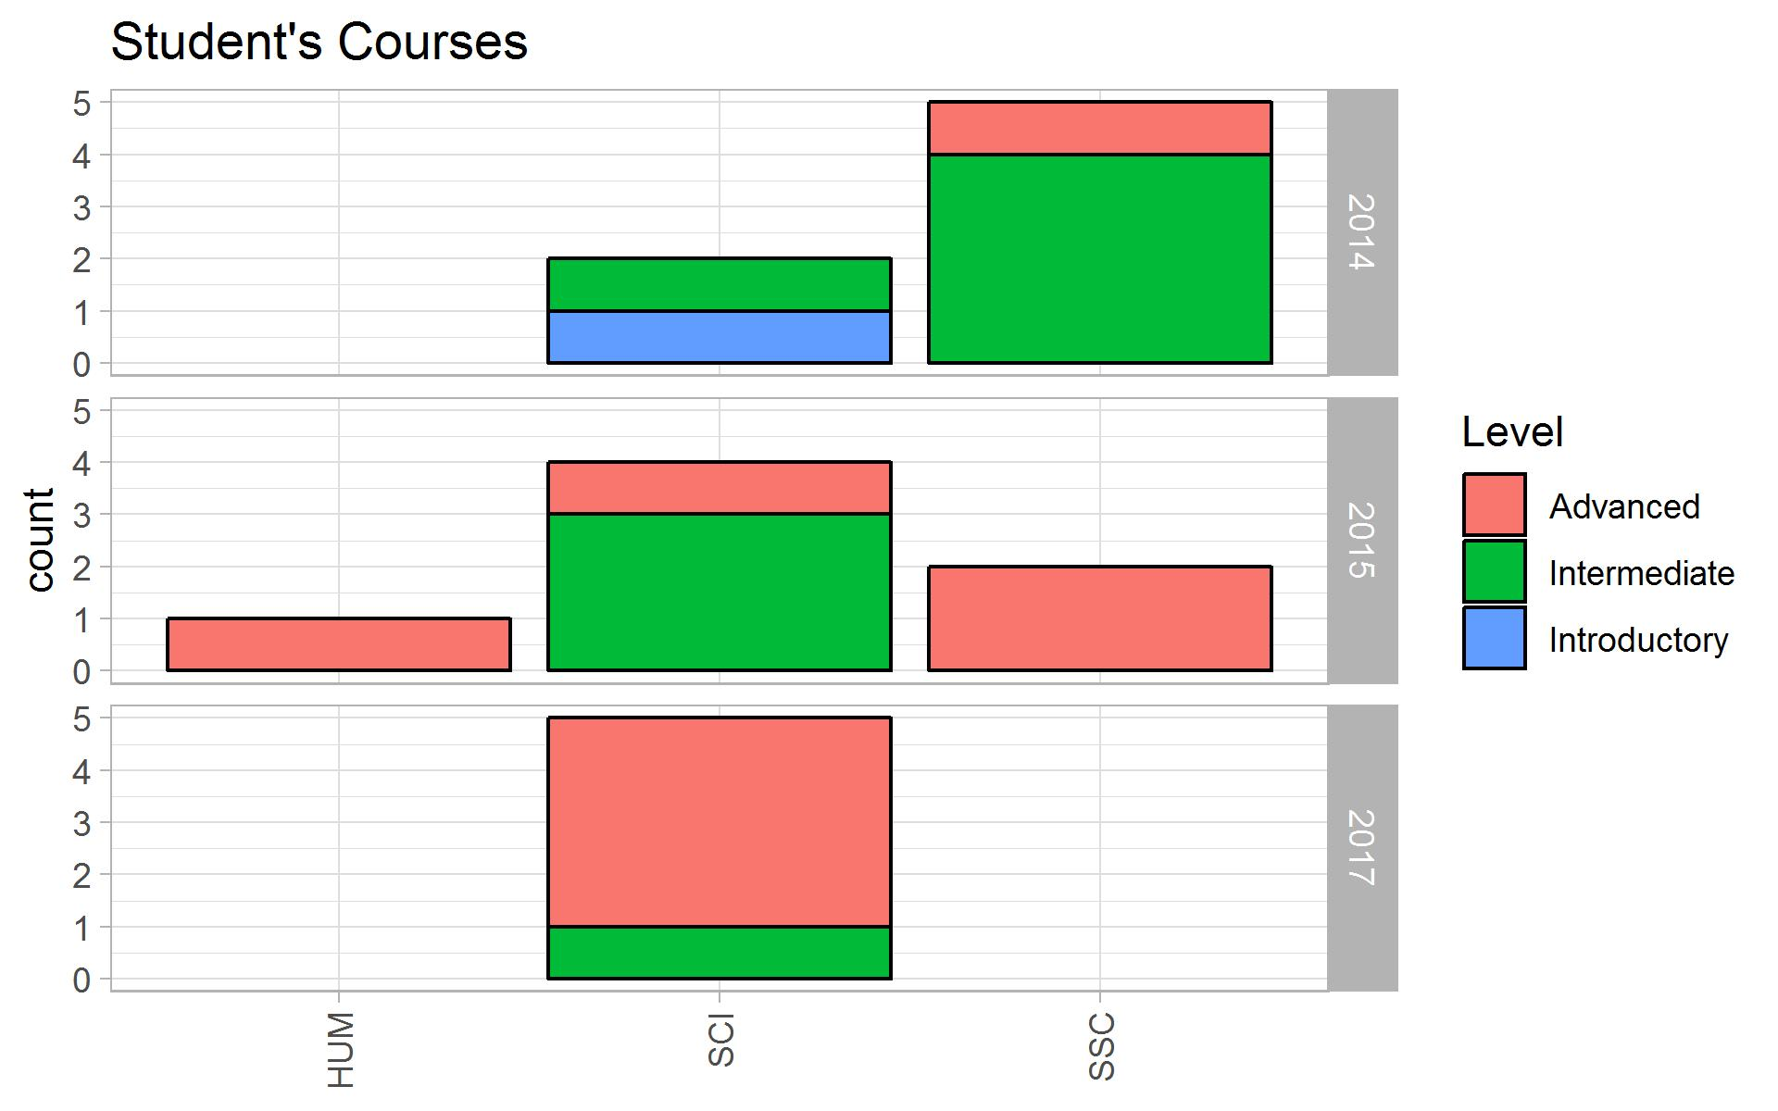
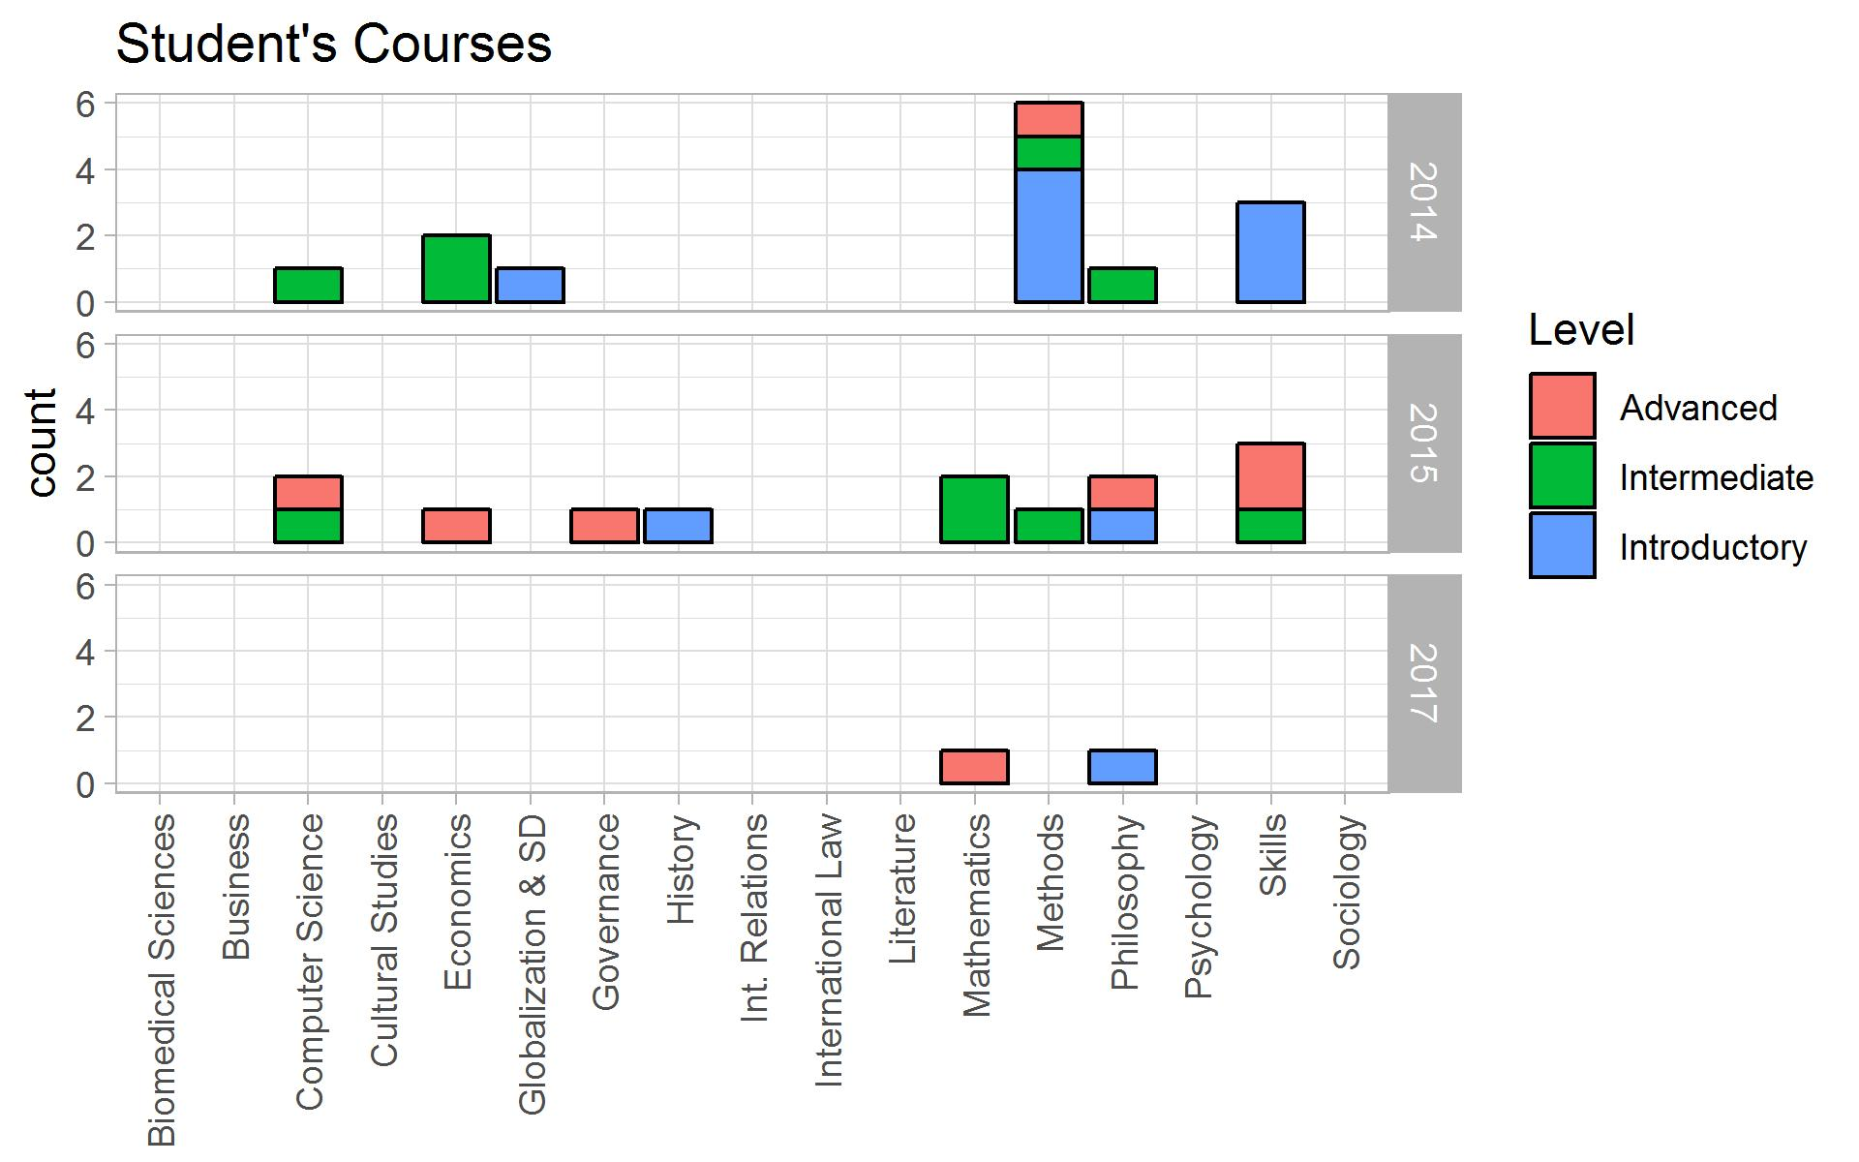

Slide 18
Contact:
Sofia Vazquez Alferez
sofia.vazquezalferez@maastrichtuniversity.nl
Raphaël Morsomme
raphael.morsomme@maastrichtuniversity.nl

